Slide 1

Music Store Data Analysis

Slide 2


Music Store Management

Slide 3

Our Team Mates
1. S. Anwar Basha
2. M. Reddappa Reddy
3. J. Guravaiah

Slide 4

Introduction
The Music Store Data Analysis project focuses on uncovering business insights from a digital music store’s database using SQL.
This analysis involves designing a relational database, importing structured data, and writing optimized SQL queries to answer key business questions. By exploring customer behavior, sales trends, and music preferences, this project helps identify opportunities to improve customer engagement and revenue.
Through this project, we aim to transform raw data into valuable insights that support strategic decision-making across marketing, operations, and artist partnerships.

Slide 5

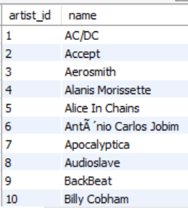
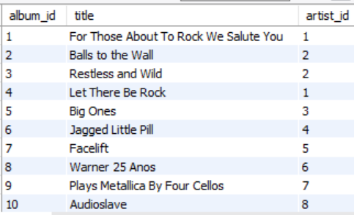
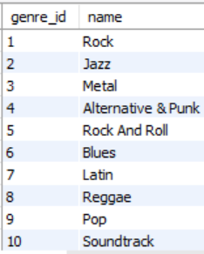
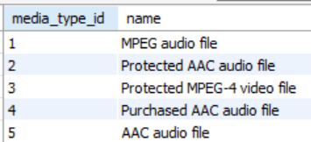
Tables
Artist
Album
Genre
Media type

Slide 6

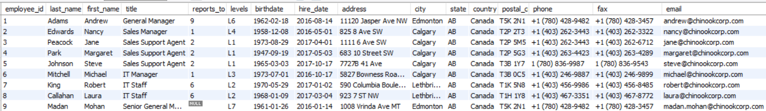
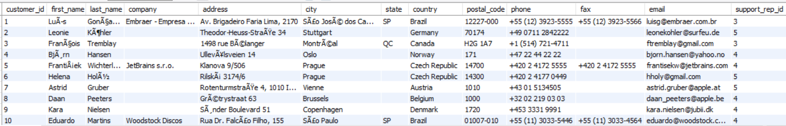
Employee
Customer

Slide 7

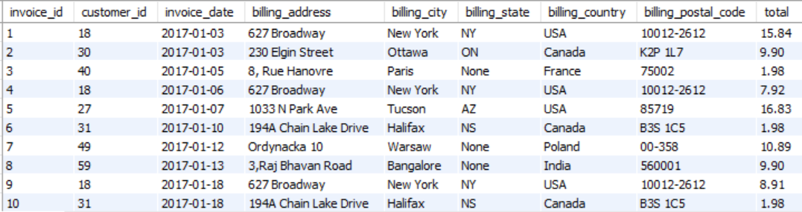
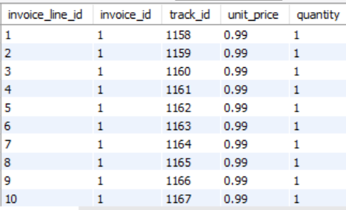
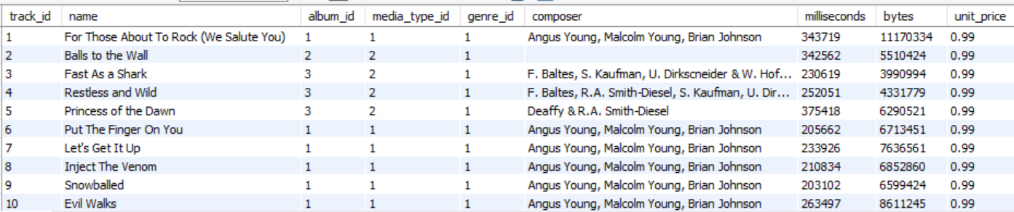
Invoice
Invoice line
Track

Slide 8

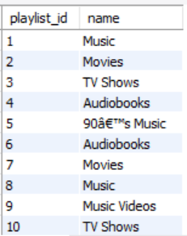
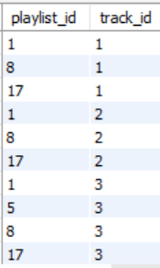
Playlist
Playlist Track

Slide 9

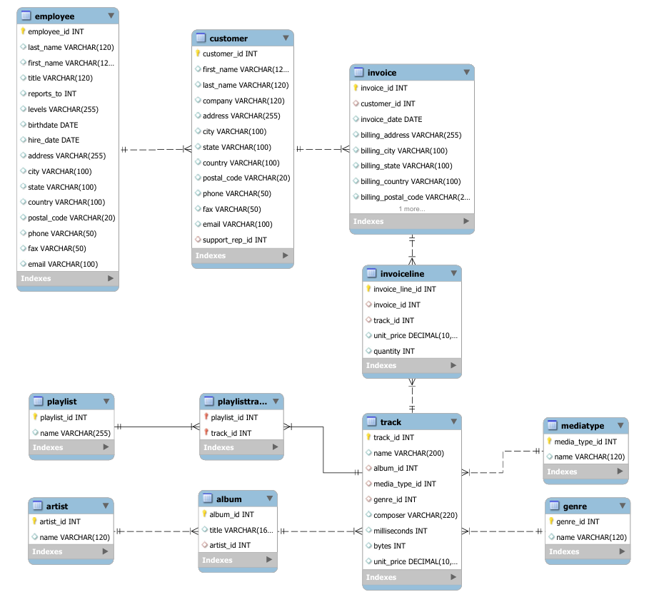
ER - Diagram

Slide 10


🎯 Problem Statement
The 🎵 Music Store holds rich data on customers, tracks, genres, artists, invoices, and playlists. Without proper analysis, this data remains underutilized and lacks strategic value.
This project aims to:
🗂️ Build a relational database with correct relationships
📥 Import large datasets efficiently into MySQL
Analyze customer behavior, music trends, and sales performance
📊 Derive insights on top customers, popular genres, and regional revenue By
converting raw data into meaningful insights, the project supports better decision-making and business growth.

Slide 11


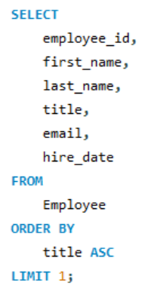
Task Queries
1. Who is the senior most employee based on job title?

Slide 12


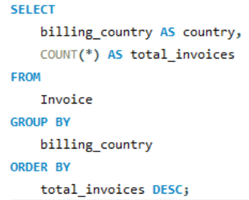
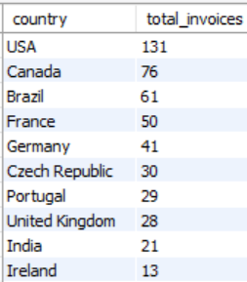
2. Which countries have the most Invoices?

Slide 13

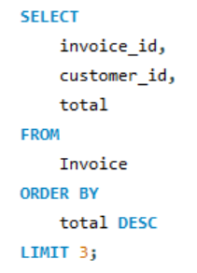
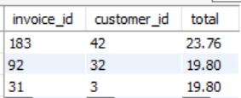

3. What are the top 3 values of total invoice?

Slide 14

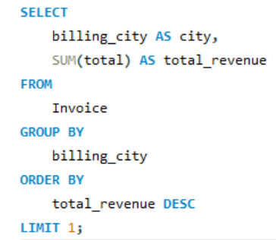
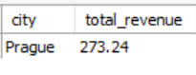
4. Which city has the best customers? - We would like to throw a promotional Music Festival in the city we made the most money. Write a query that returns one city that has the highest sum of invoice totals. Return both the city name & sum of all invoice totals

Slide 15

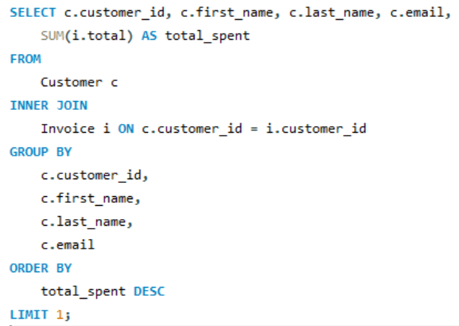

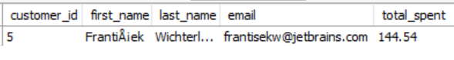
5. Who is the best customer? - The customer who has spent the most money will be declared the best customer. Write a query that returns the person who has spent the most money

Slide 16


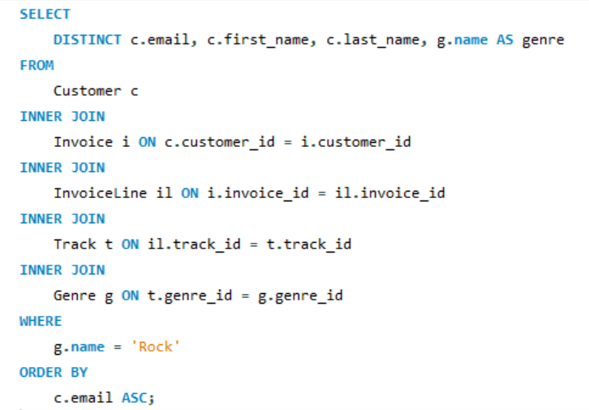
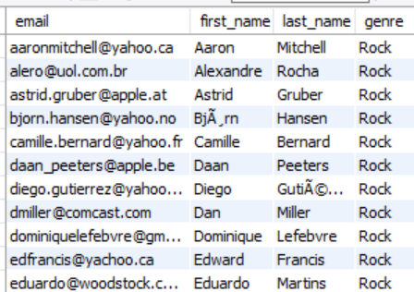
6. Write a query to return the email, first name, last name, & Genre of all Rock Music listeners. Return your list ordered alphabetically by email starting with A

Slide 17

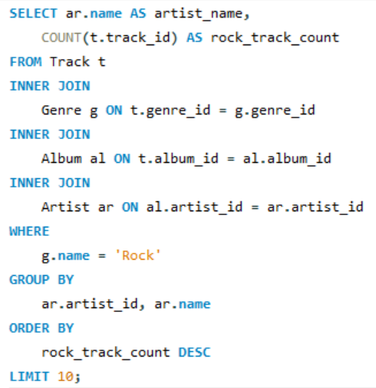

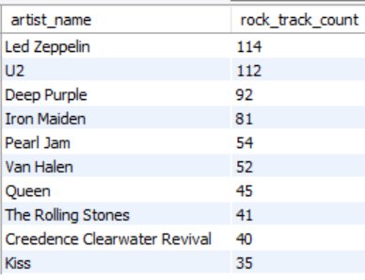
7. Let's invite the artists who have written the most rock music in our dataset. Write a query that returns the Artist name and total track count of the top 10 rock bands

Slide 18

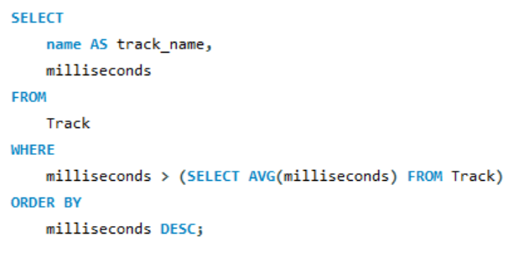
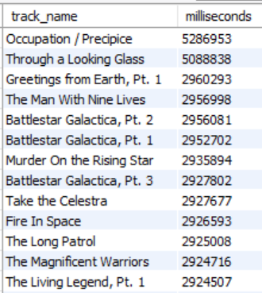

8. Return all the track names that have a song length longer than the average song length.- Return the Name and Milliseconds for each track. Order by the song length, with the longest songs listed first

Slide 19

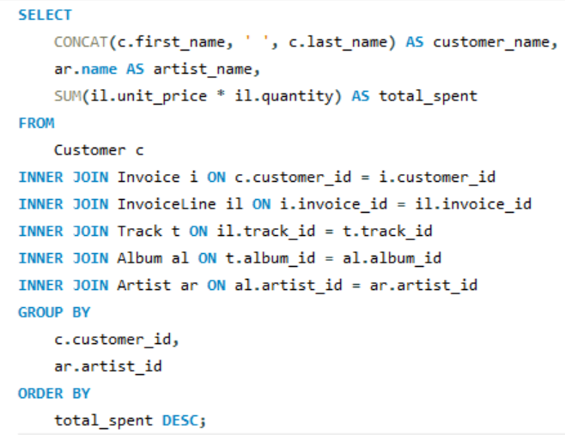
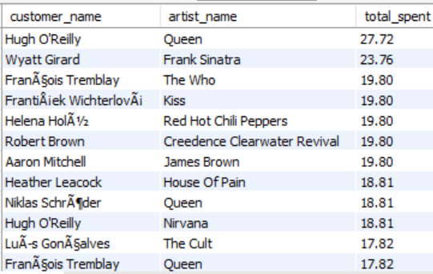
9. Find how much amount is spent by each customer on artists? Write a query to return customer name, artist name and total spent

Slide 20

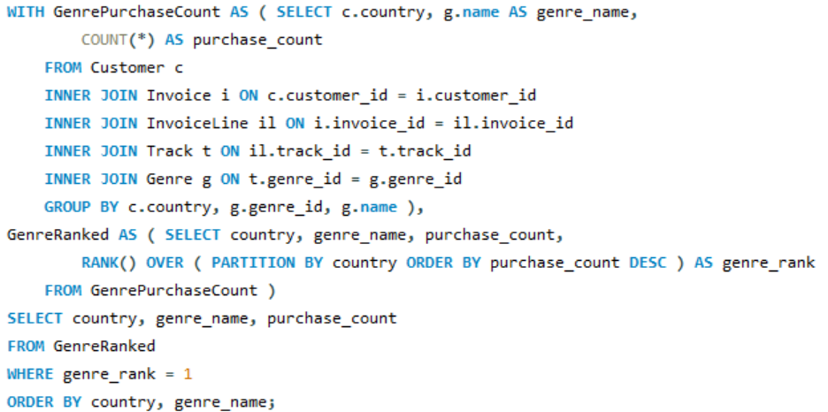
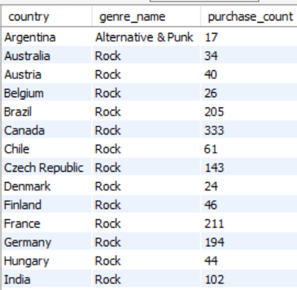
10. We want to find out the most popular music Genre for each country. We determine the most popular genre as the genre with the highest amount of purchases. Write a query that returns each country along with the top Genre. For countries where the maximum number of purchases is shared, return all Genres

Slide 21

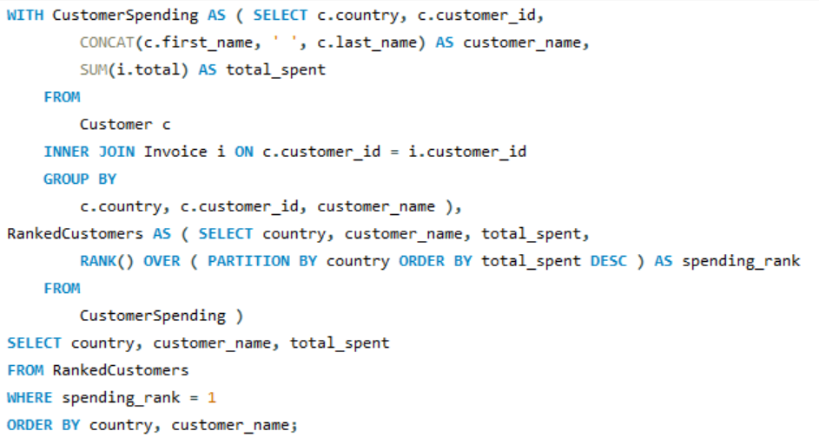
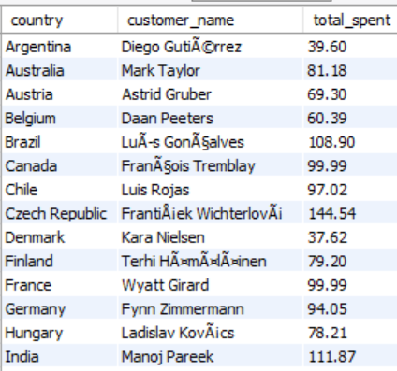
11. Write a query that determines the customer that has spent the most on music for each country. Write a query that returns the country along with the top customer and how much they spent. For countries where the top amount spent is shared, provide all customers who spent this amount

Slide 22

Conclusion
The Music Store Data Analysis project successfully demonstrated how structured database design and advanced SQL queries can turn raw data into valuable business insights.
By importing and analyzing data across multiple tables such as customers, invoices, tracks, and genres we were able to:
Identify top-performing customers and high-revenue regions
Discover popular music genres and top artists
Understand customer spending patterns and sales trends
This project not only strengthened SQL and database management skills but also provided a practical understanding of how data-driven decisions can enhance business performance and customer engagement.

Slide 23


